Slide 1
Managing Vinho Verde
Wine Quality
Fixed acidity
Volatile acidity(aroma)
Citric acid
pH
Alcohol
Density
Residual Sugar
C-Level Consulting Group
Rosie Rong
Tingwei Li
Yingxin Lin
Chlorides(saltiness)
Free sulfur dioxide
Total sulfur dioxide
Sulphates

Slide 2
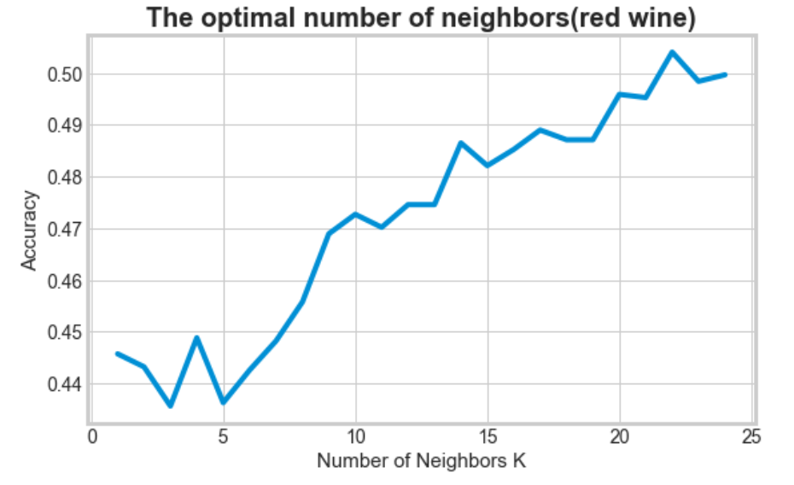
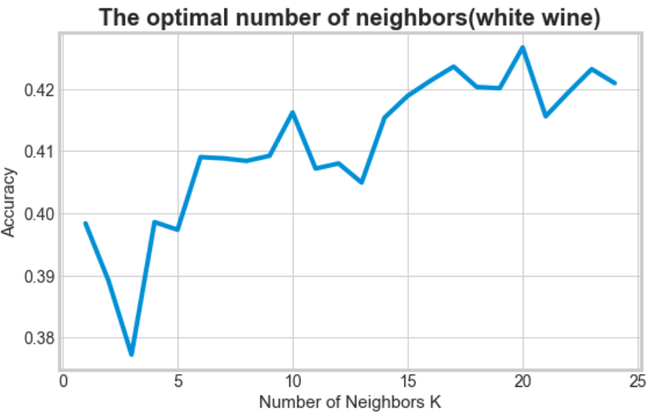
KNN - Multiple classes
k=22
accuracy=0.5
k=20
accuracy=0.43
Red wine quality classes: 3 - 8
White wine quality classes: 3 - 9

Slide 3
SVM - Multiple classes)
Grid Search:
C: [range(1,10)]
gamma: [0.1,0.2,..., 1.2,1.3,1.4]
Best combination:
C:7
gamma: 0.8
Red wine
Accuracy: 0.589
White wine
Accuracy: 0.627

Slide 4
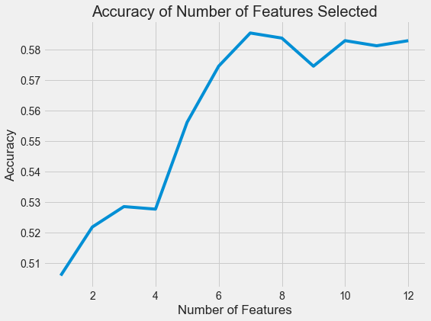
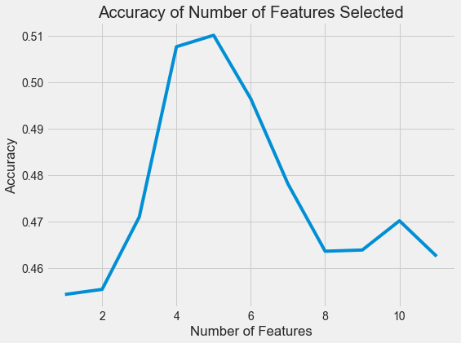
Red wine - logistic regression
(Quality class 3-8)
White wine - logistic regression
(Quality class 3-9)
Highest accuracy:
5 features
Highest accuracy:
7 features
7 features: volatile acidity,citric acid, residual sugar,density,pH,sulphates,alcohol
Accuracy: 0.546
5 features: fixed acidity,volatile acidity, residual sugar, pH,alcohol
Accuracy: 0.522

Slide 5
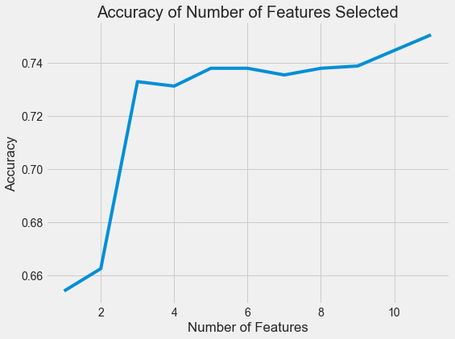
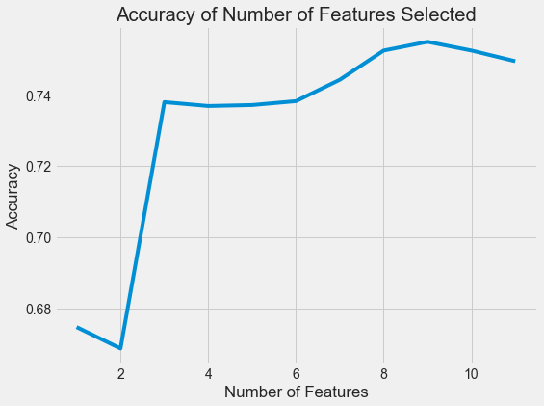
Binary: 0 - Low quality (class 3 - 5)
1 - High quality (class 6 - 8)
Binary: 0 - Low quality (class 3 - 5)
1 - High quality (class 6 - 9)
Highest accuracy:
9 features
Highest accuracy:
11 features
Eliminated features: free sulfur dioxide total sulfur dioxide
Accuracy: 0.711
Accuracy: 0.737

Slide 6
So how to improve wine quality?
Red wine binary logistic regression model:
Y = exp( -1.23 - 0.042*fixed_acidity - 3.05*volatile_acidity - 0.80*citric_acid - 0.016*residual_sugar - 0.84*chlorides + 0.024*free_sulfer_dioxide - 0.017*total_sulfur_dioxide - 0.89*density - 1.74*pH + 2.23*sulphates + 0.90*alcohol) / (1+exp(...))
White wine binary logistic regression model:
Y = exp( -5.83 - 0.17*fixed_acidity - 5.56*volatile_acidity - 0.38*citric_acid + 0.031*residual_sugar - 0.32*chlorides - 2.09*density + 0.0028*pH + 1.43*sulphates + 0.99*alcohol) / (1+exp(...))
We want higher:
- Free sulfur dioxide
- Sulphates
- Alcohol
We want higher:
- Residual sugar
- pH
- Sulphates
- Alcohol

Slide 7
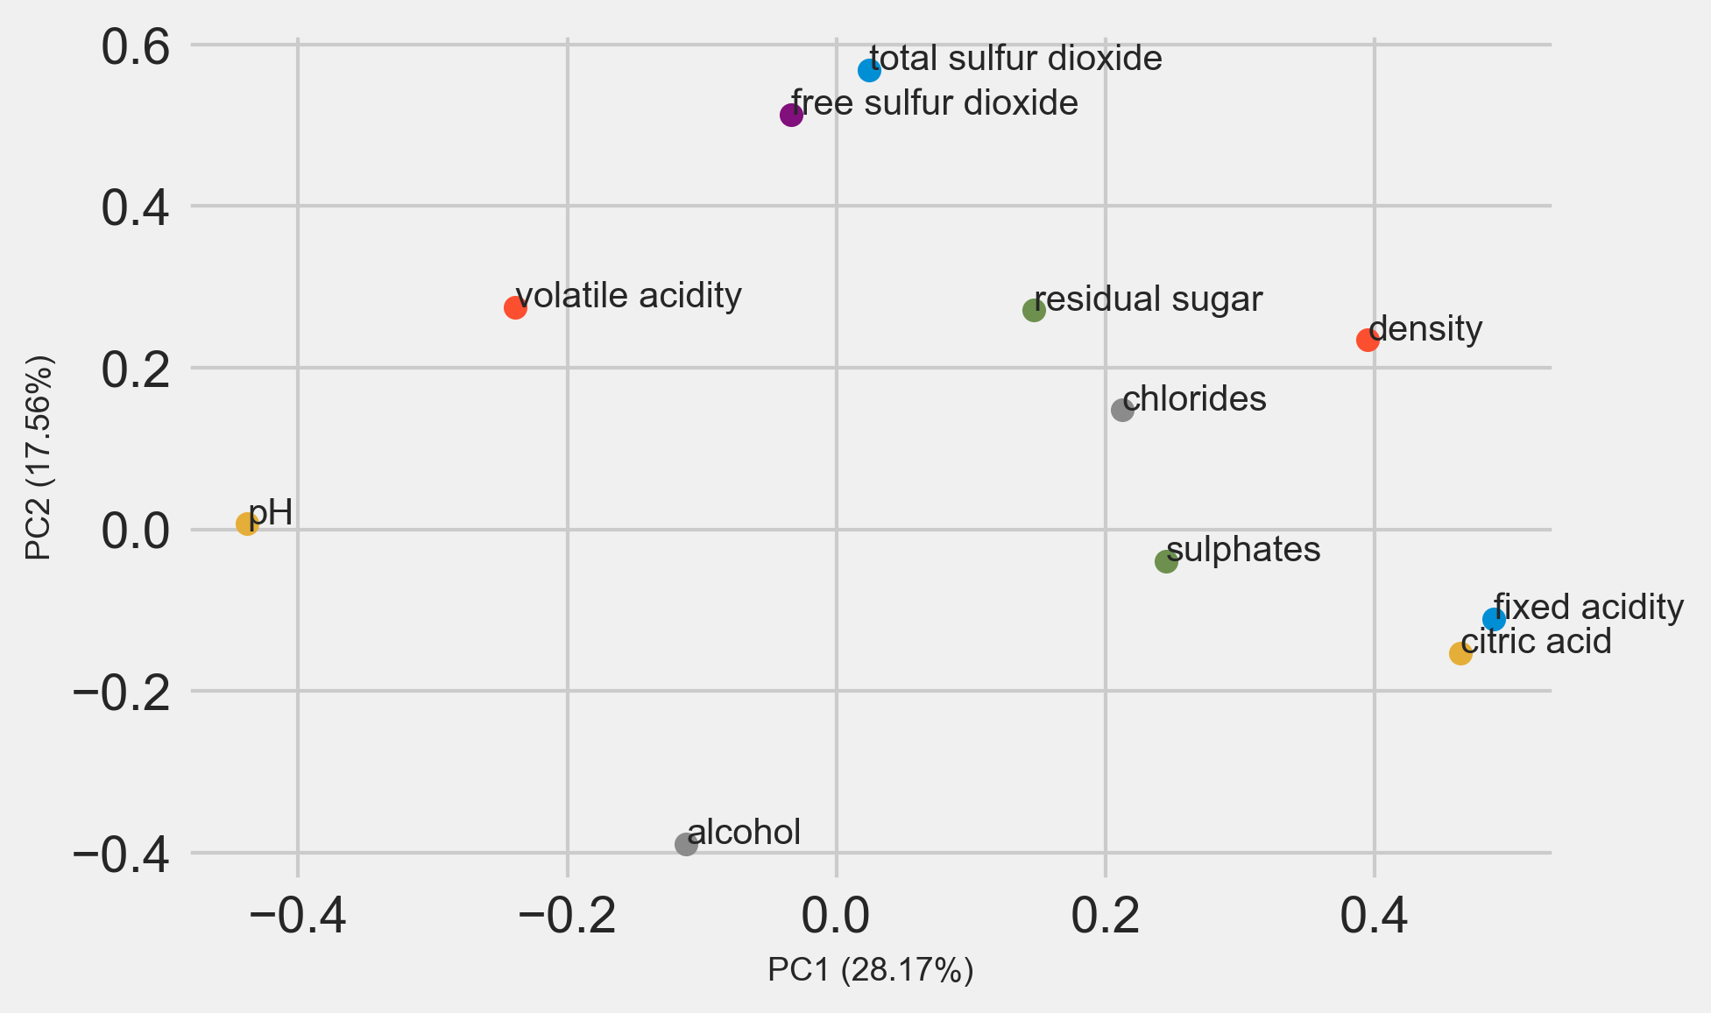
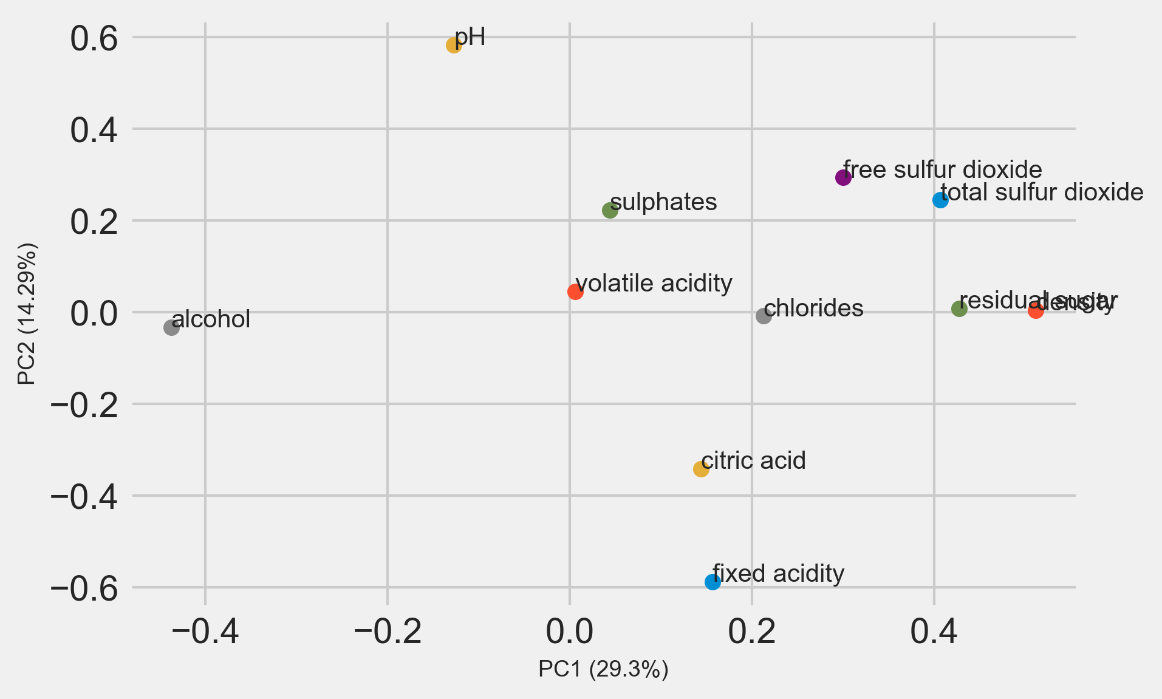
PCA loadings plot
White_wine
Red wine

Slide 8
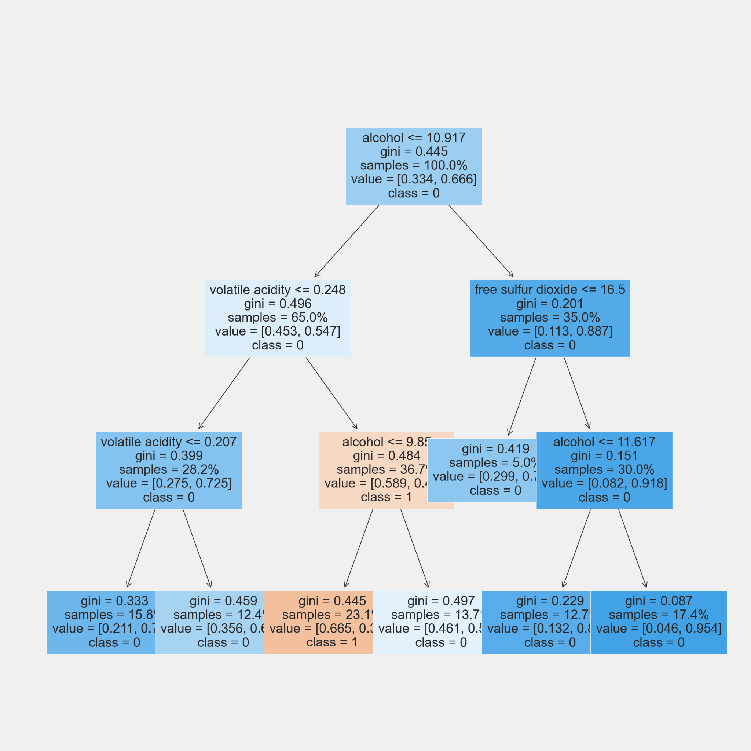
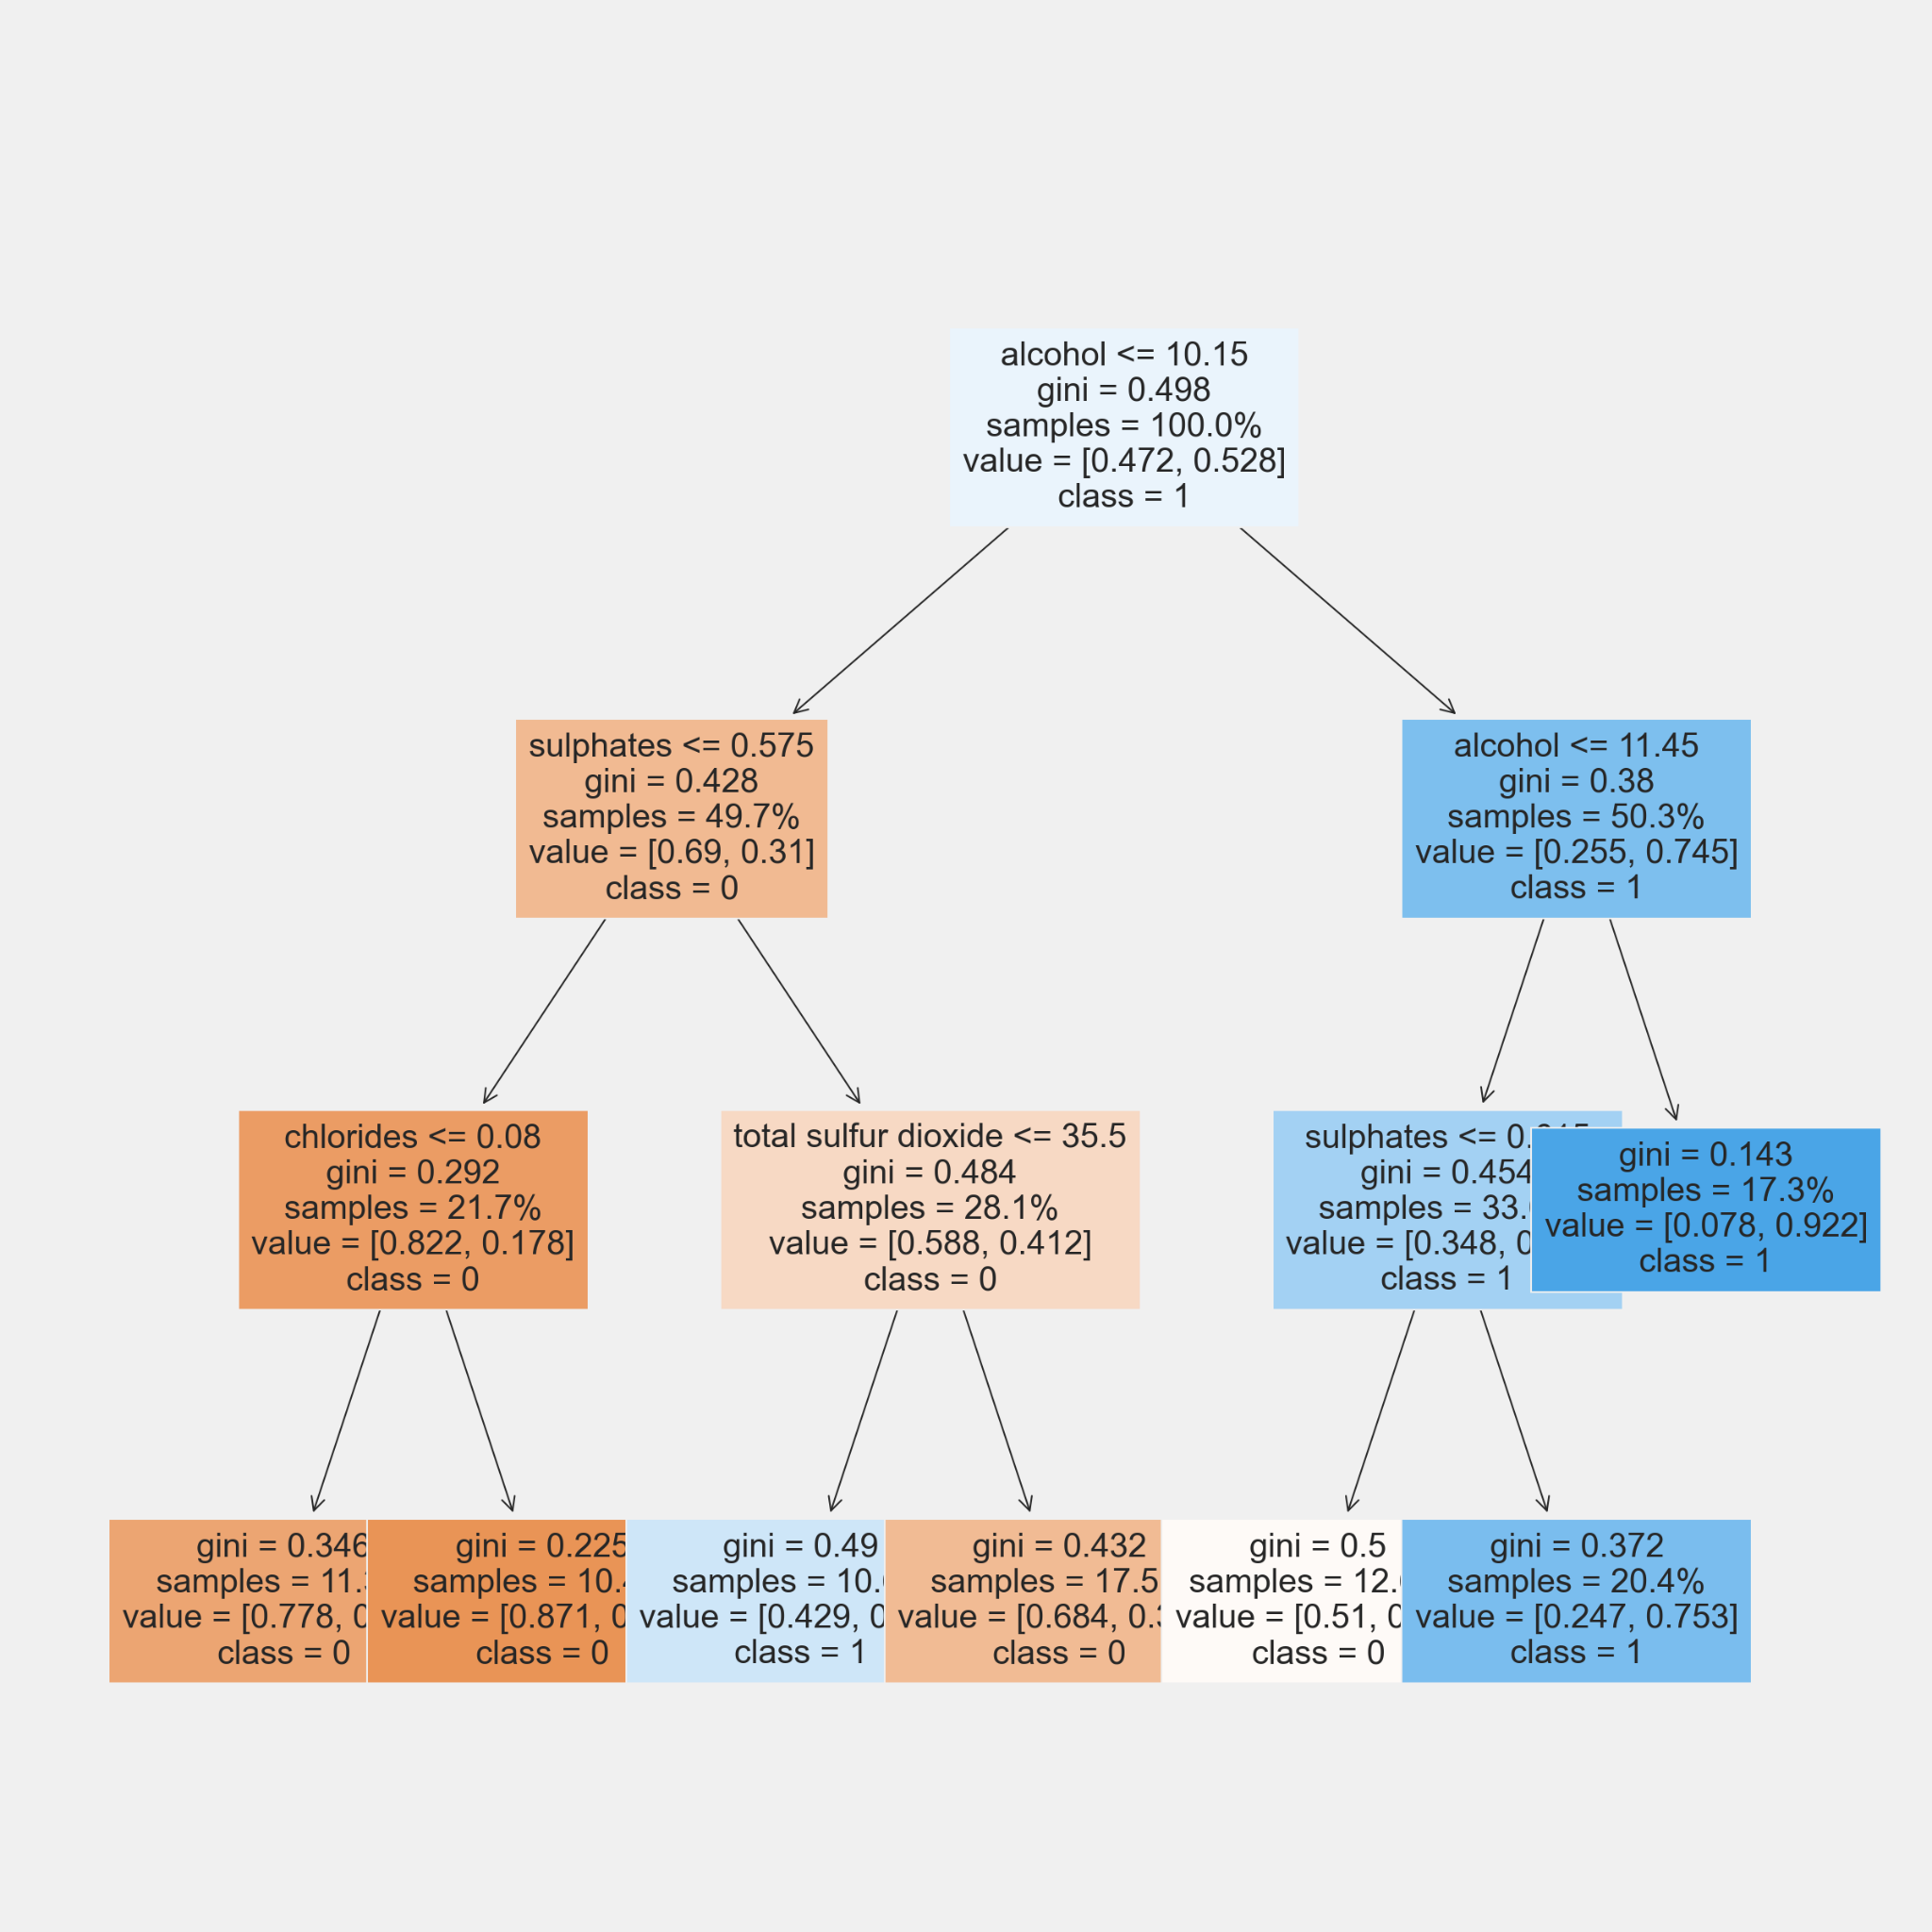
Decision Tree
White Wine: 0.748 Red Wine: 0.707

Slide 9

Comparison
MODEL | KNN | SVM | Logistic Regression | Logistic Regression | Decision Tree
 | Multiple Classes |  |  | Binary
ACCURACY -White | 0.427 | 0.589 | 0.522 | 0.737 | 0.748
ACCURACY -Red | 0.505 | 0.627 | 0.546 | 0.711 | 0.707

Slide 10

Thank you for listening!
Q & A

Slide 11
Appendix

Slide 12

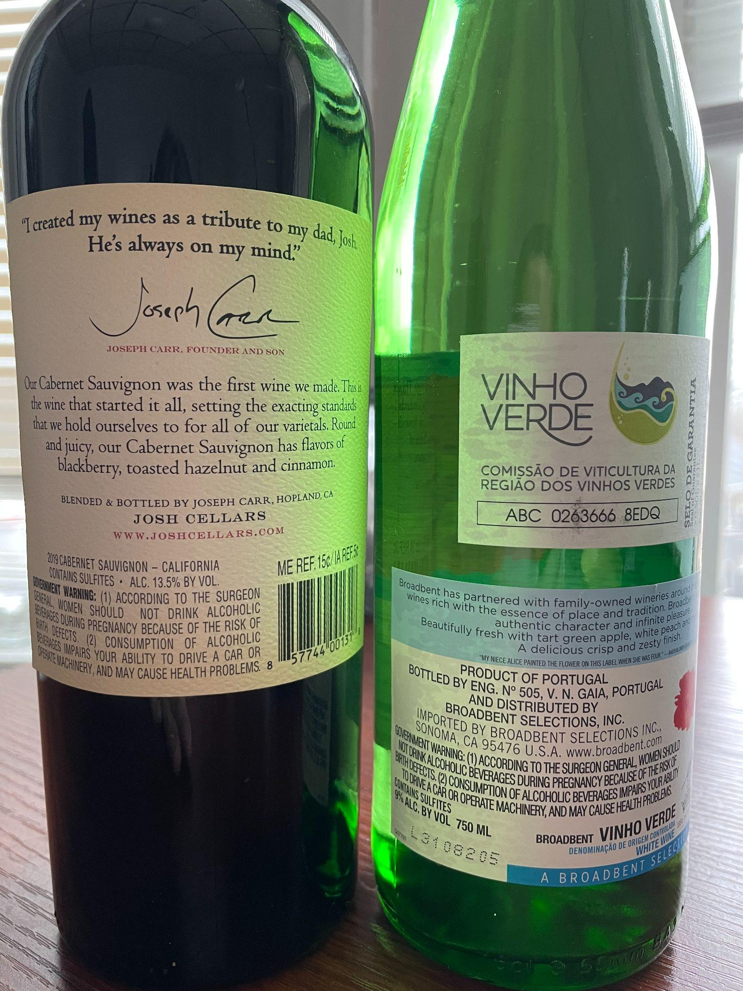
13.5% 9%
Don’t drink during pregnancy.
Don’t drink and drive.

Slide 13
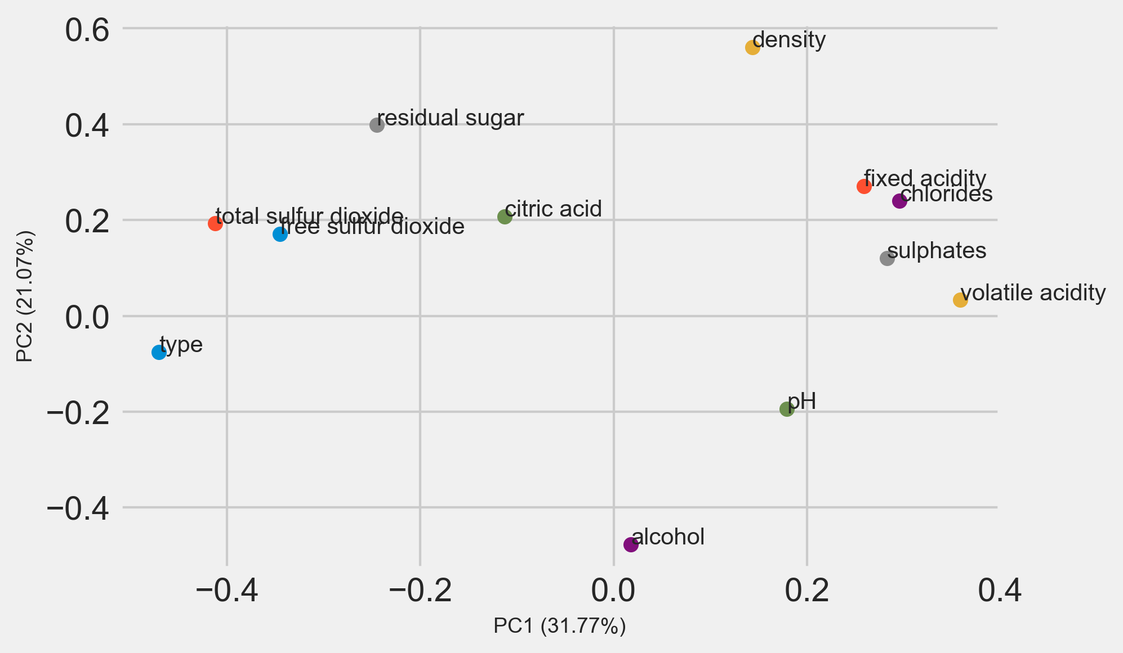
PCA for both wine type

Slide 14
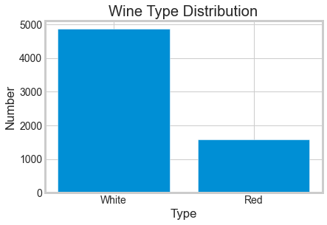
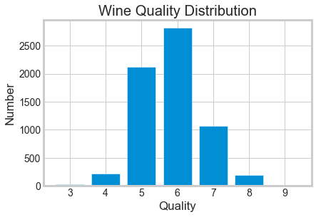
About the dataset

Slide 15
1 - fixed acidity | The predominant fixed acids found in wines are tartaric, malic, citric, and succinic.
2 - volatile acidity | Made from compounds in types of acid found in wine, showing an aroma, rather than found on the palate.
3 - citric acid | Citric acid is often added to wines to increase acidity, complement a specific flavor or prevent ferric hazes.
4 - residual sugar | The quantity of sugar left in the wine after the fermentation process.
5 - chlorides | Chlorides is a major contributor to saltiness
6 - free sulfur dioxide | The amount of free SO2 needed is based on the pH of the wine. A fairly safe amount for protection of the wine is either . 5 ppm for red wines or . 8 ppm for white wines.
7 - total sulfur dioxide | Total Sulfur Dioxide (TSO2) is the portion of SO2 that is free in the wine plus the portion that is bound to other chemicals in the wine such as aldehydes, pigments, or sugars.
8 - density | Density is defined as the mass, or weight, per volume of a material. In the case of liquids, density is often measured in units of g/mL, which is the weight in grams (g) of each milliliter (mL) of liquid. The density of wine is primarily determined by the concentration of alcohol, sugar, glycerol, and other dissolved solids.
9 - pH | Winemakers use pH as a way to measure ripeness in relation to acidity. Low pH wines will taste tart and crisp, while higher pH wines are more susceptible to bacterial growth.
10 - sulphates | Wine sulfites are naturally occurring at low levels in all wines, and are one of the thousands of chemical by-products created during the fermentation process.
11 - alcohol | Alcohol percentage.

Slide 16
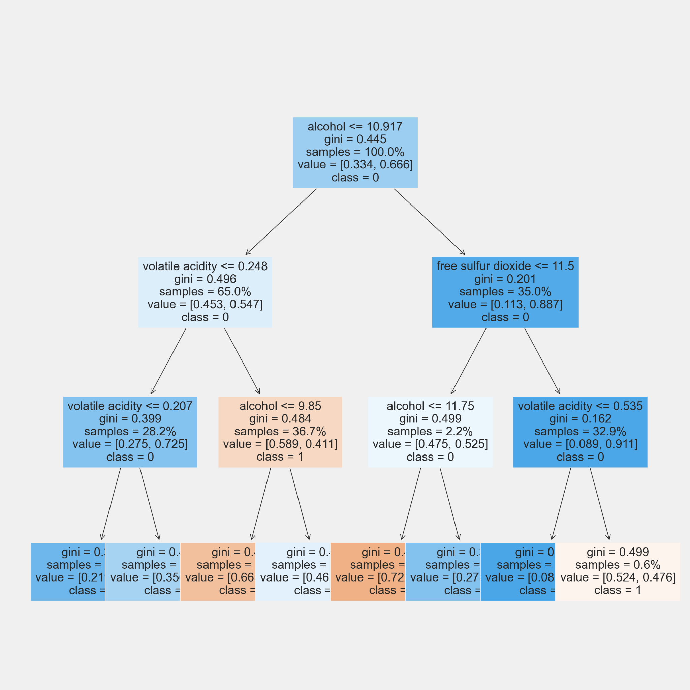
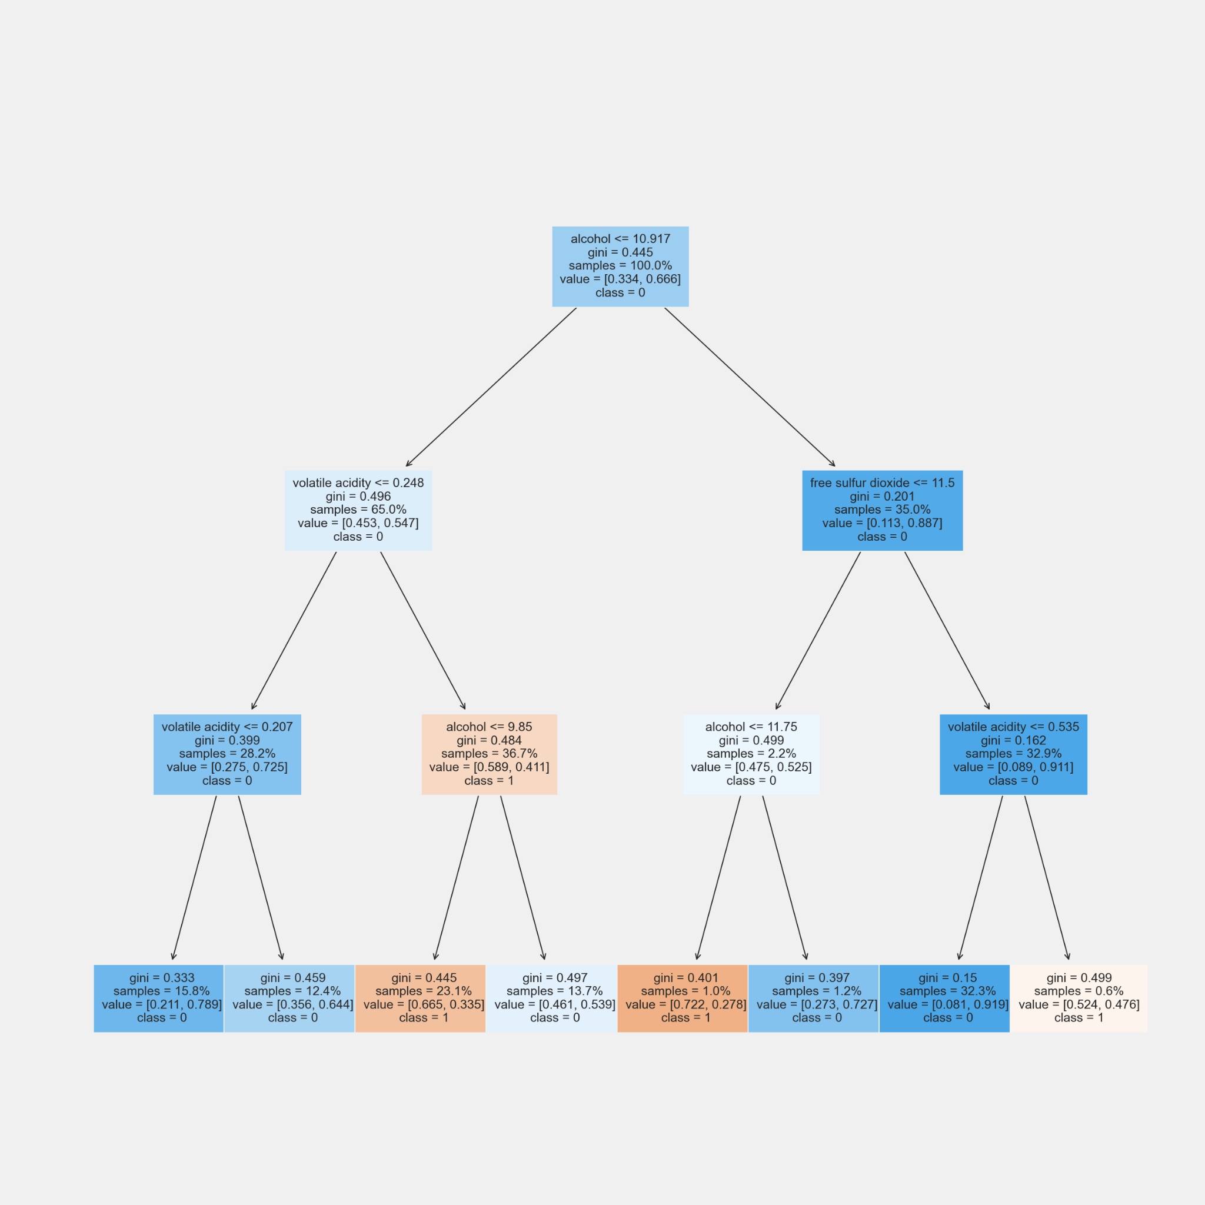
Decision Tree
White wine

Slide 17
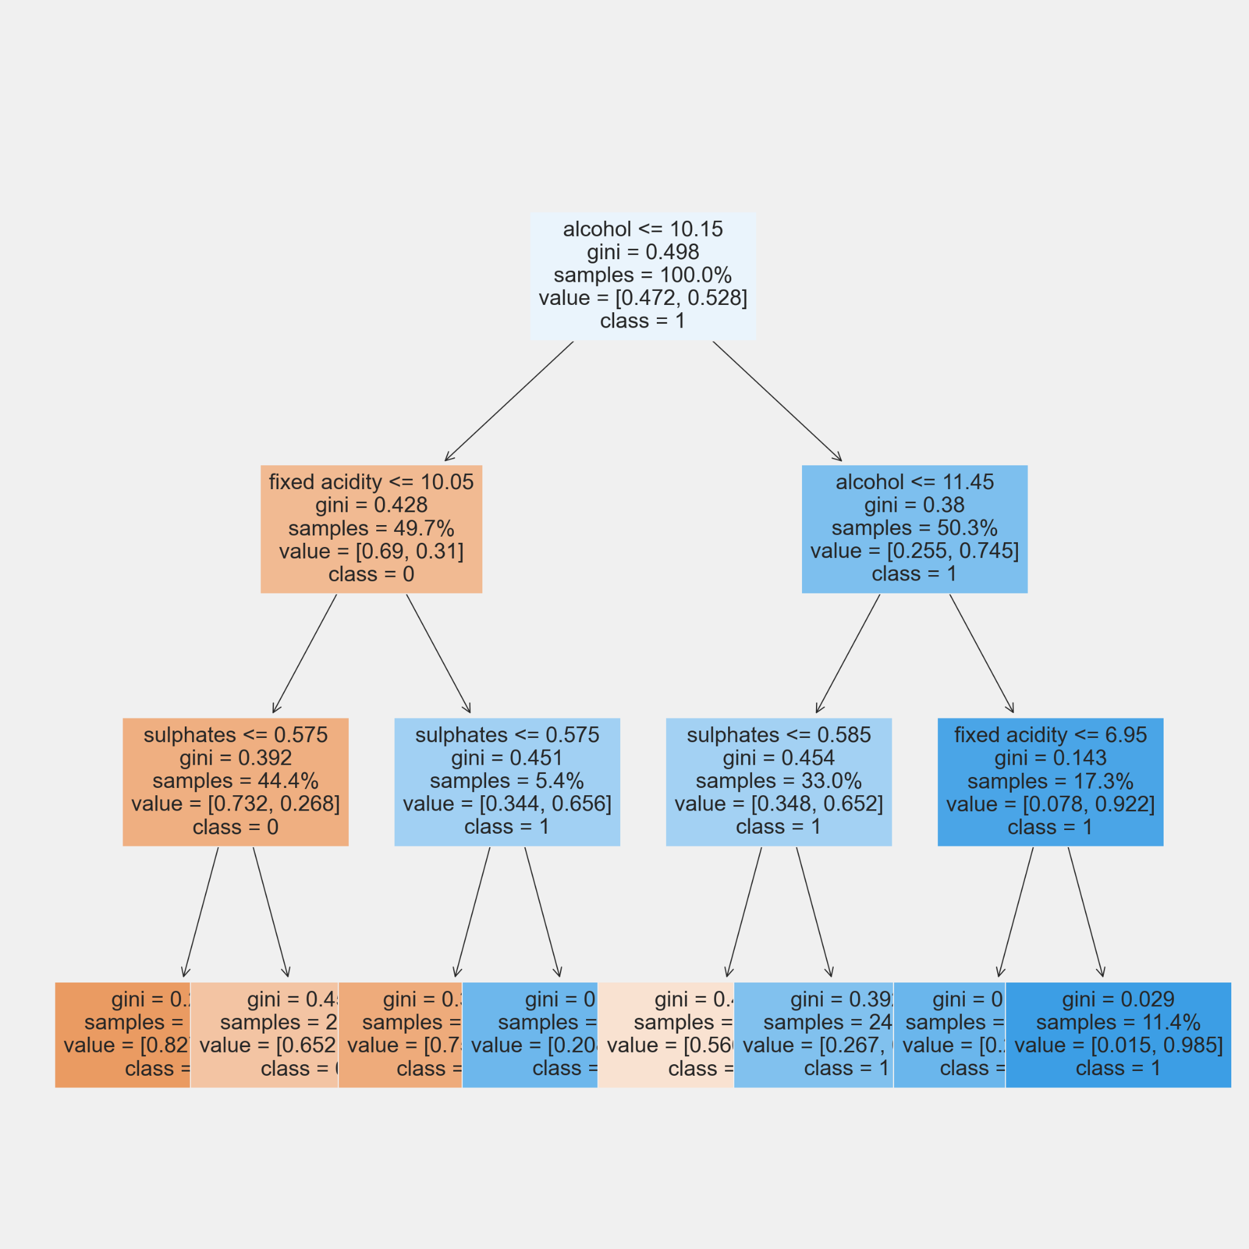
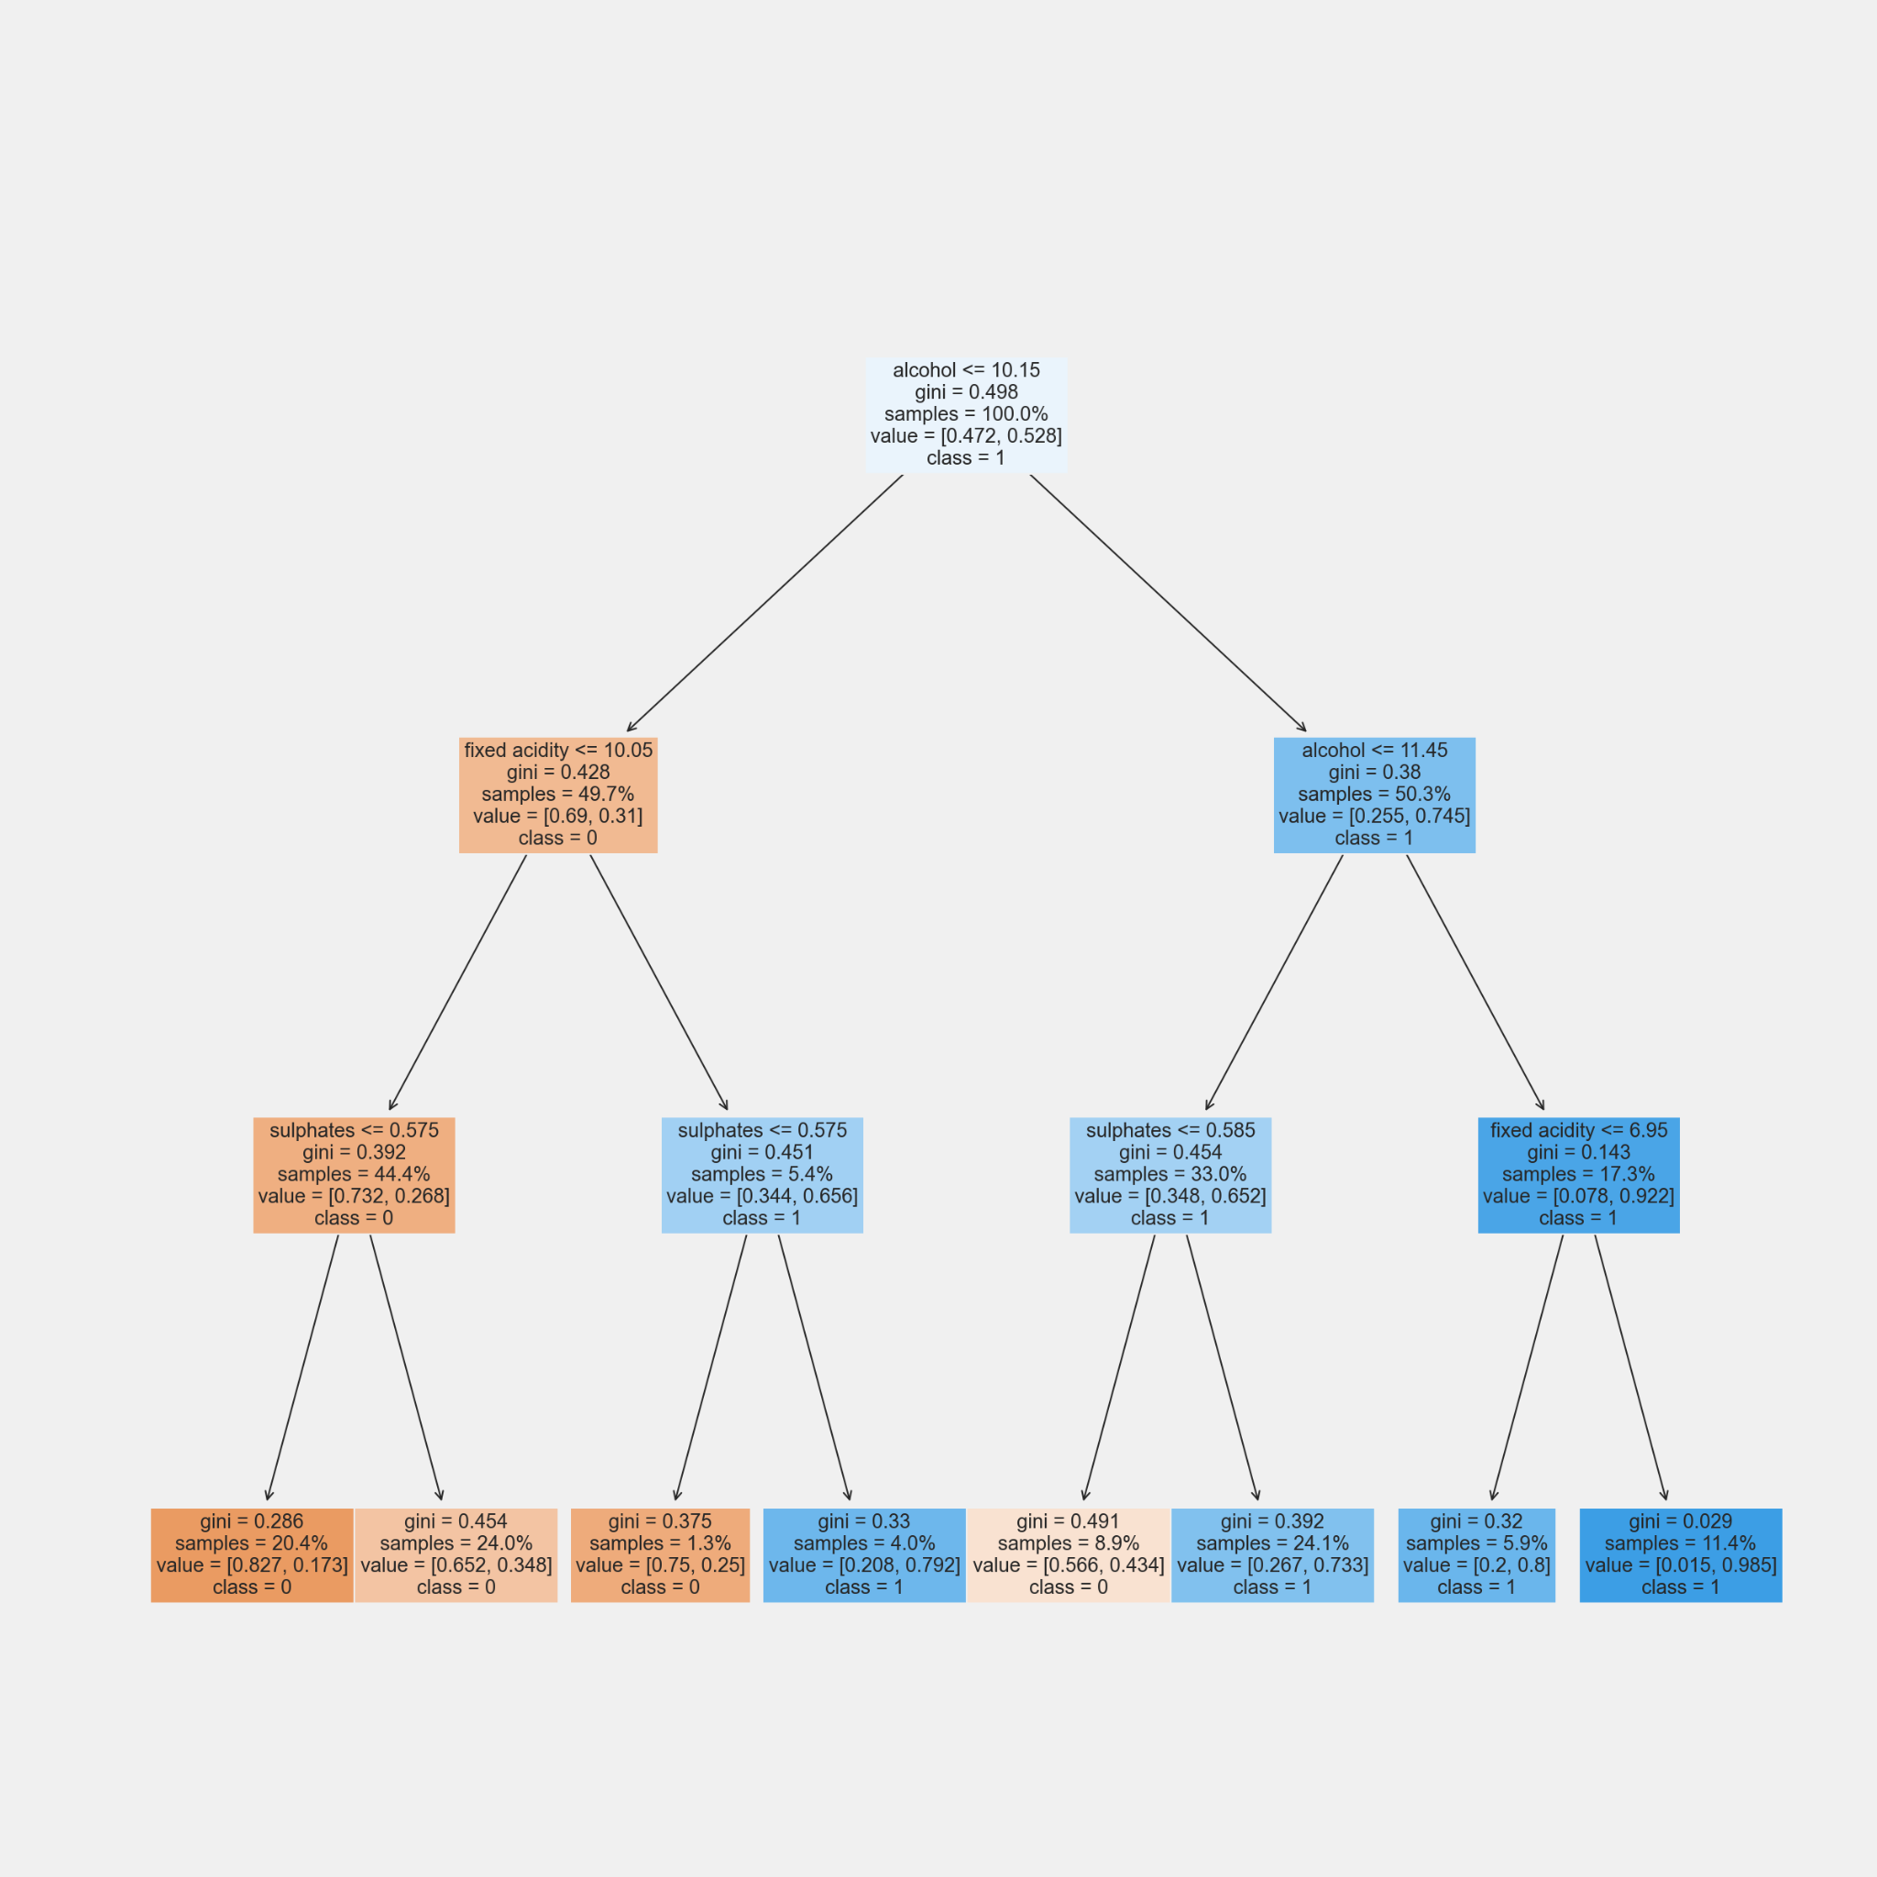
Decision Tree
Red wine

Slide 18
Logistic Regression - multiple class
Red wine
Step 2: Feature Selection
Step 3: Use selected features to fit a model
Step 4: Calc confusion matrix and accuracy score
Step 1: Split Data
(Training/Testing)
(Red wine/White wine)
Step 6: Compare
Red vs. White
Step 5: Use coef and intercept to plot sigmoid
White wine
Same as above

Slide 19
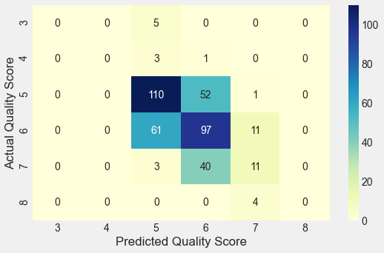
Red wine - Fit logistic regression
Accuracy_score (y_test, y_pred):
0.5463659147869674

Slide 20
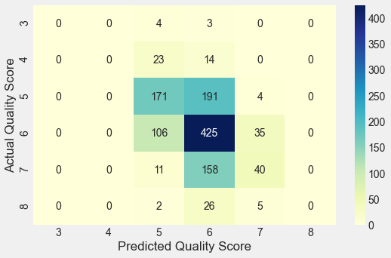
white wine - fit logistic regression
Accuracy_score (y_test, y_pred):
0.5221674876847291

Slide 21
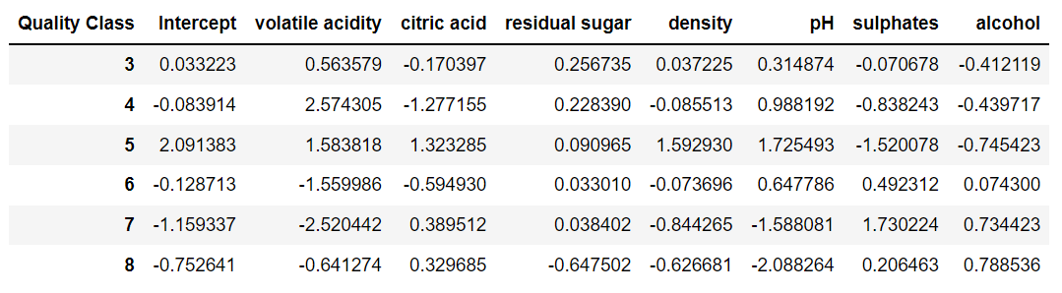
Red wine - coefficients & intercepts (Multi-classes)
Example: Quality class 3 model
Y = exp(0.033+0.56*volatile_acidity-0.17*citric_acid+0.26*residual_sugar
+0.037*density+0.31*pH-0.071*sulphates-0.41*alcohol) / (1+exp(...))

Slide 22
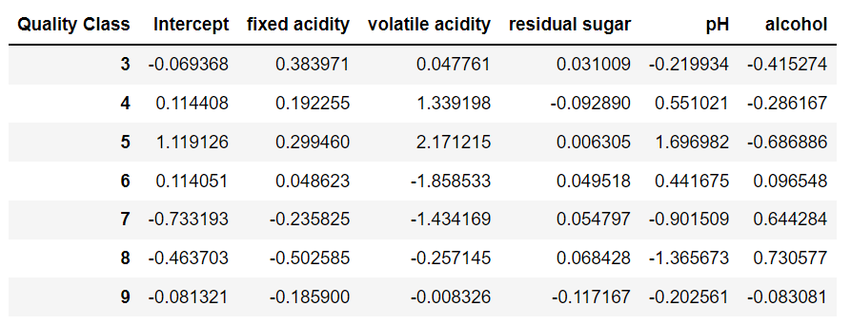
white wine - coefficients & intercepts (Multi-classes)
Example: Quality class 3 model
Y = exp(-0.069 + 0.38*fixed_acidity + 0.048*volatile_acidity +
0.031*residual_sugar - 0.22*pH - 0.42*alcohol) / (1+exp(...))

Slide 23
Red wine - coefficients & intercepts (Binary)
Binary model:
Y = exp(-1.23-0.042*fixed_acidity-3.05*volatile_acidity-0.80*citric_acid-0.016*residual_sugar
-0.84*chlorides+0.024*free_sulfer_dioxide-0.017*total_sulfer_dioxide-0.89*density-1.74*pH
+2.23*sulphates+0.90*alcohol) / (1+exp(...))

Slide 24
white wine - coefficients & intercepts (Binary)
Binary model:
Y = exp(-5.83 - 0.17*fixed_acidity - 5.56*volatile_acidity - 0.38*citric_acid + 0.031*residual_sugar
-0.32*chlorides - 2.09*density + 0.0028*pH -+ 1.43*sulphates + 0.99*alcohol) / (1+exp(...))

Slide 25
Red vs. white
Wine type | Optimal number of features | Features selected | Model accuracy
Red wine | 7 | ‘volatile acidity’ ‘citric acid’ ‘residual sugar’ ‘density’ ‘pH’ ‘sulphates’ ‘alcohol’ | 0.5463659147869674
White wine | 5 | ‘fixed acidity’ ‘ ‘volatile acidity’ ‘residual sugar’ ‘pH’ ‘alcohol’ | 0.5221674876847291

Slide 26
KNN
Step 1: Split Data
(Training/Testing)
Step 2: StandScaler
( z = (x - u) / s )
Step 3:
Fit and predict
Step 4: Adjust hyperparameter

Slide 27
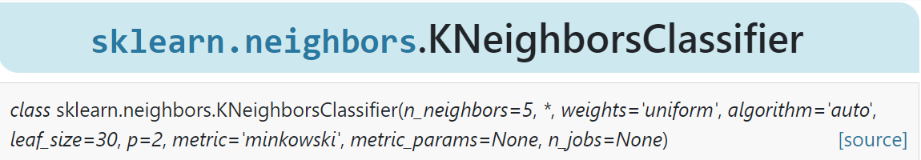

KNN
HyperParameter:
n_neighbors
weights
uniform
distance
Metric = minkowski
p
default=2(Euclidean metric)

Slide 28
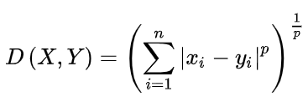
KNN
HyperParameter:
n_neighbors
weights
uniform
distance
Metric = minkowski
p
default=2(Euclidean metric)

Slide 29
KNN
Grid Search:
'weights': ['uniform', 'distance'],
'n_neighbors': [range(1, 11)],
'p': [range(1, 6)]
Best combination:
distance
n_neighbors = 10
P = 1
Accuracy score=0.6453

Slide 30
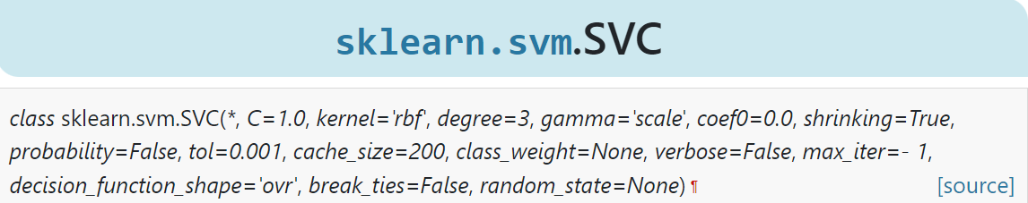
SVM
Step 1: Split Data
(Training/Testing)
Step 2:
Fit and predict
Step 3: Adjust hyperparameter
C & gamma

